Slide 1
Secure Data Hiding in images using Stegnography
CAPSTONE PROJECT
Presented By:
Student Name : Jithin B P
College Name & Department : Amrita Vishwa vidhyapeedam, Kochi. Department of Computer Science and IT

Slide 2
OUTLINE
Problem Statement
Technology used
Wow factor
End users
Result
Conclusion
Git-hub Link
Future scope

Slide 3
Problem Statement
The data we send is not secure in its raw form. Any types of confidentiality can be met. To mitigate this we use steganography to hide the important data inside an image.

Slide 4
Technology used
Language used: python
Libraries used: opencv, os
System specification: AMD ryzen 5, 8GB RAM
Platform used: Windows

Slide 5
Wow factors
Data is hided inside an image without any change in detailing of the image.

Slide 6
End users
Big MNCs
Military application
Banking sector

Slide 7
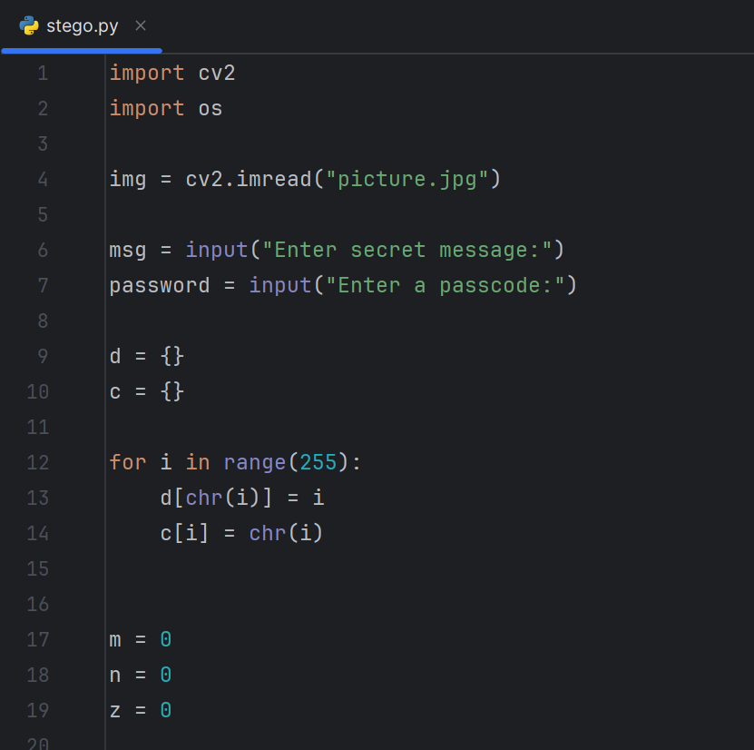
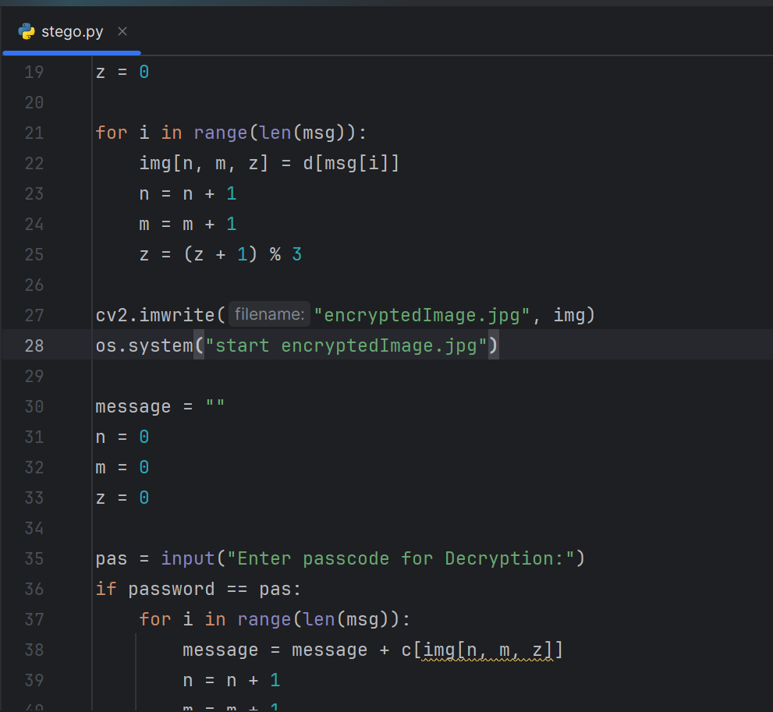
Results

Slide 8
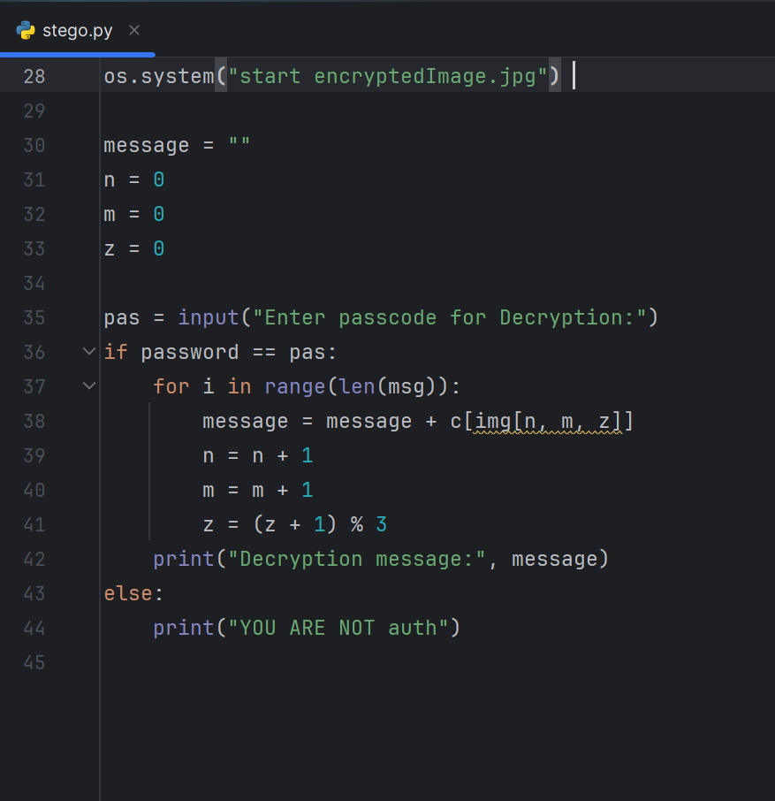
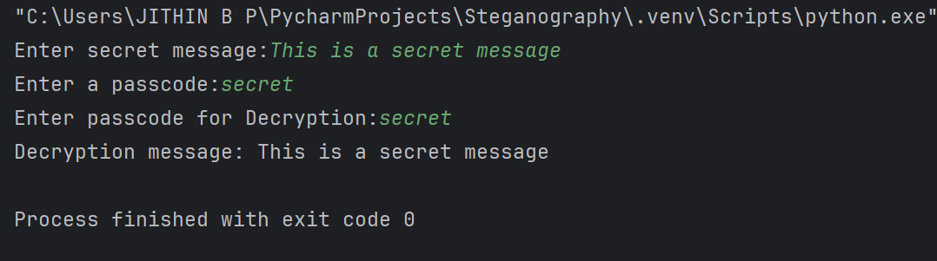
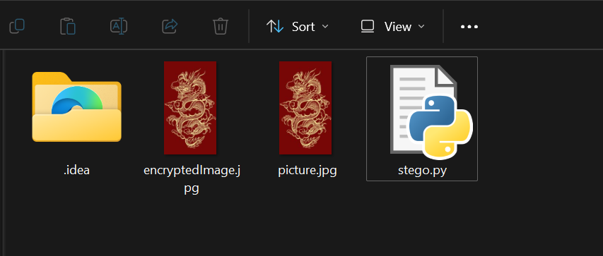

Slide 9
Conclusion
Successfully encrypted the important data inside an image using steganography.

Slide 10
GitHub Link
https://github.com/Jithin-b-p/Steganography

Slide 11
Future scope(optional)

Slide 12
THANK YOU

